Slide 1
AMERICAN INTERNATIONAL UNIVERSITY-BANGLADESH (AIUB)
FACULTY OF ARTS AND SOCIAL SCIENCES
DEPARTMENT OF ENGLISH
SPRING 2021-2022
B-19
ASSIGNMENT ABOUT COVID-19
PRESENTED BY
A. F. M RAFIUL HASSAN
ID: 22-47048-1

Slide 2
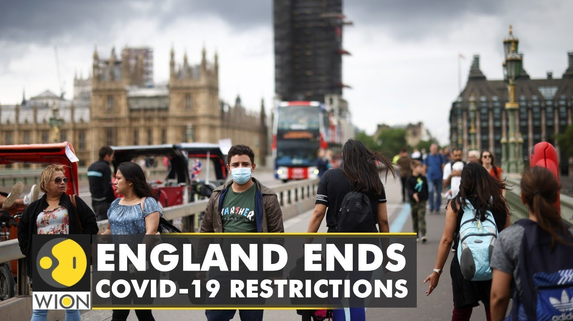
THE END OF COVID RESTRICTION IN ENGLAND.
Author: Luke McGee
Article title: Plans to end legal Covid-19 restrictions in England.
Published in: CNN
Publish date: February 21, 2022

Slide 3
Introduction
Originating from the province of Wuhan, China, Coronavirus has taken a huge death toll during the last 2 years around the whole world. After imposing several lockdowns and restrictions, governments are planning to push to a living with covid society rather than a living against covid society. As a step towards, the UK PM Boris Johnson plans to announce the end of covid restrictions in England.

Slide 4
Body
Covid to move from government restrictions to personal responsibility.
As per the PM, people should try to live with the covid and normalize the issue.
Covid will not suddenly disappear, so the country will continue researching for more variants and cures.

Slide 5
Upon the approval of the parliament, covid restrictions will be withdrawn in phases.
The rule of self-isolation if tested positive will end on February 24th
Employees will no longer be obliged to inform employers if tested positive, nor the people in contact will be traced.
The government will stop free rapid tests for the public from April 1.

Slide 6
Few protection measures will remain in practice.
The domestic surveillance system will go on.
vaccination programs and antiviral programs will Continue to be upgraded.

Slide 7

Conclusion
To deal with the covid situation and to regain their economic position, countries are under pressure of normalizing the pandemic. The UK is no exception. Besides in the face of accusations of breaking the lockdown law by himself and his staff, the PM also tends to have a hurry to end the controversies by withdrawing the covid restrictions.

Slide 8
Thank You ☺

